Slide 1
The TABBY Program in Hungary j With financial support of the DAPHNE program of the European Union JLS/2009-2010/DAP/AG JUST/2011-2012/DAP/AG/3259
PARTI, Katalin
ESZTER Foundation Hungary partikat@gmail.com

Slide 2
TABBY in Internet www.tabby.eu
TABBY: intends to Threat Assess the Bullying Behaviour iin Youth
Complex program for surveying and managing cyber- and school bullying incidents ⇒ comparable data
Countries: Italy, Greece, Cyprus, Bulgaria, Hungary, France, Spain, Poland (2nd round)
Funding:
EU project "DAPHNE II" JLS/2009-2010/DAP/AG
EU project "DAPHNE III" JUST/2011-2012/DAP/AG
Duration:
2011 – 2015

Slide 3
What is bullying?
Scientific definition (Olweus, 1993; Farrington, 1993)
intent to cause harm (physical, verbal or physiological attack or intimidation)
imbalance of power (psychological or physical)
repeated incidents or continued act over a prolonged period
Cyberspace (email, IM, SNS etc.)
one act can be a starting point of an
ongoing or repeated act

Slide 4
SCHOOL S STAFF
(teachers, experts, guidance councelors)
(cyber)bullying can have a direct impact over students at school
Cyberbullying is highly correlated to school bullying (continuation or retaliation)
STUDENTS
(11-18 y.o.)
Students do not tell about their (cyber)bullying victimization (35-50%, depending on age)
If telling somebody: likely peers and friends
Anti-bullying programs: teachers and students together can be more effective
Students not skilled to know how to react
Self-
report
online
questionnaire:
to assess
the risk they
run
Peer mentor
training:
To get to
know what to do
against bullying
How to help
others to stop
the bully, etc.
Training for
Teachers;
Monito-ring
school
activities
of teachers
and peer
mentors

Slide 5
Product #1: The TABBY toolkit online questionnaire available for free
Subjective factors of risk | Objective factors of risk
SNS presence | SES
befriending someone, knowing friends | how long they are online a day?
populatiry | whether teachers and parents talk about internet security
victimization of B and CB
offending of B and CB
(acts in details)
Specific Qs
internet addiction
sexting
moral disengagement
behavioral emotional status

Slide 6
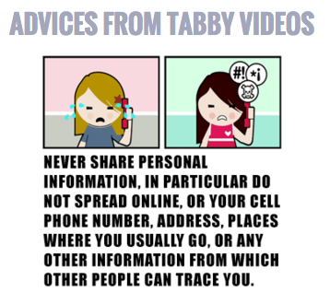
Longitudinal data collection on kids’ risky activities
2011-2012: 215 students (11-18 y.o.)
2013-2014: 582 students (11-18 y.o.)
interactive games
using the TABBY videos
30 peer mentors trained (2011-2013)
moduls
sensitization
how to early detect and manage bullying and cyberbullying situations
how to help students in need
how to motivate peers to stand up for each other
how to deal with targets, offenders and bystanders
risky situations
when it is necessary (a must) to tell an adult

Slide 7
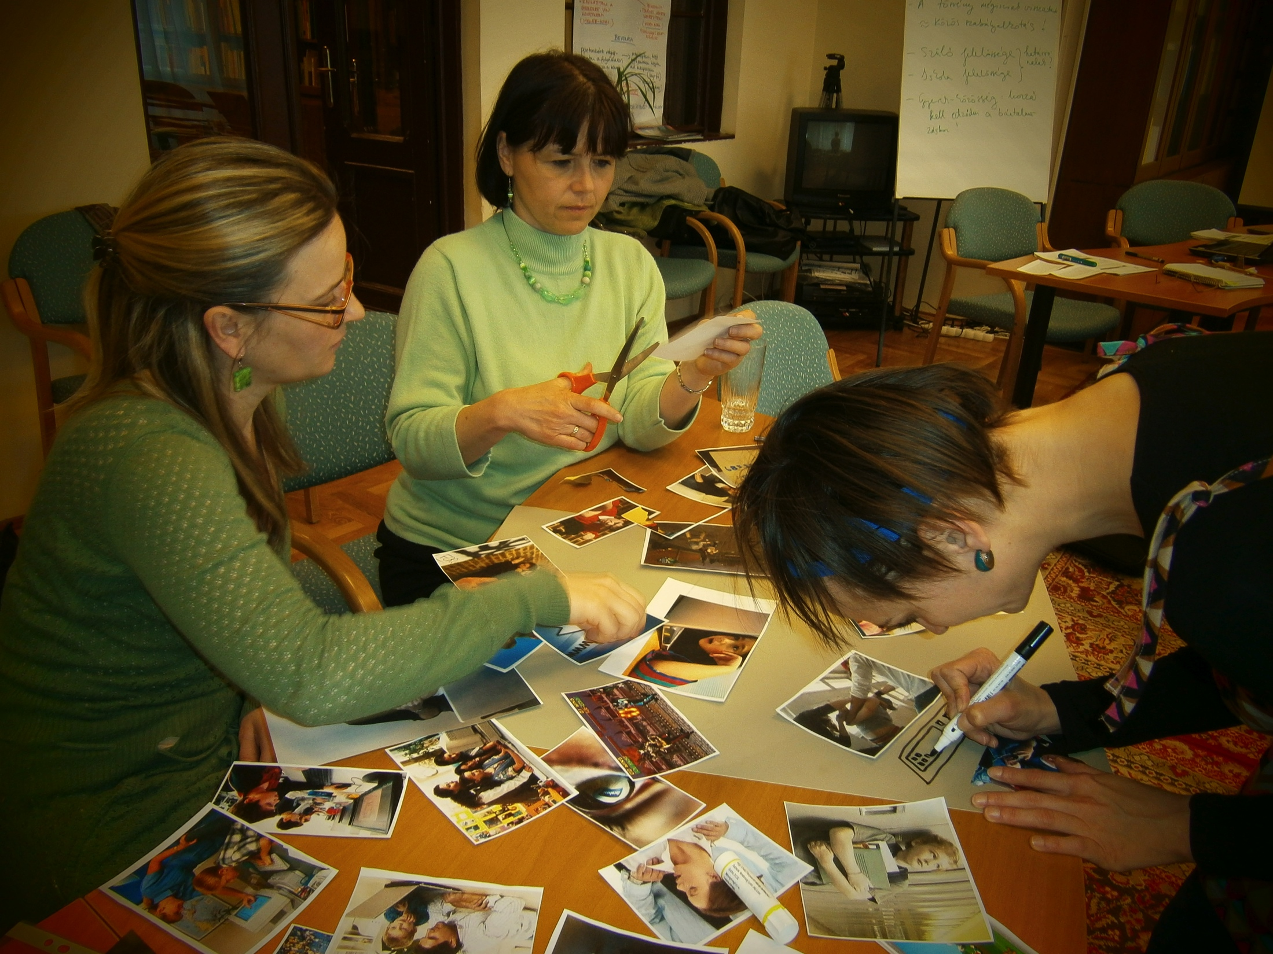
Product #2: School staff training
accredited 2x6 hours training
frontal presentations + interactive games
using the TABBY Booklet
80 teachers/guidance counselors trained (2011-2015)
moduls
sensitization
how to early detect and manage bullying and cyberbullying situations
how to involve students in the solution
how to deal with targets, offenders and bystanders
how to speak with parents
what to avoid (maleficient solutions)
when to notify the police

Slide 8
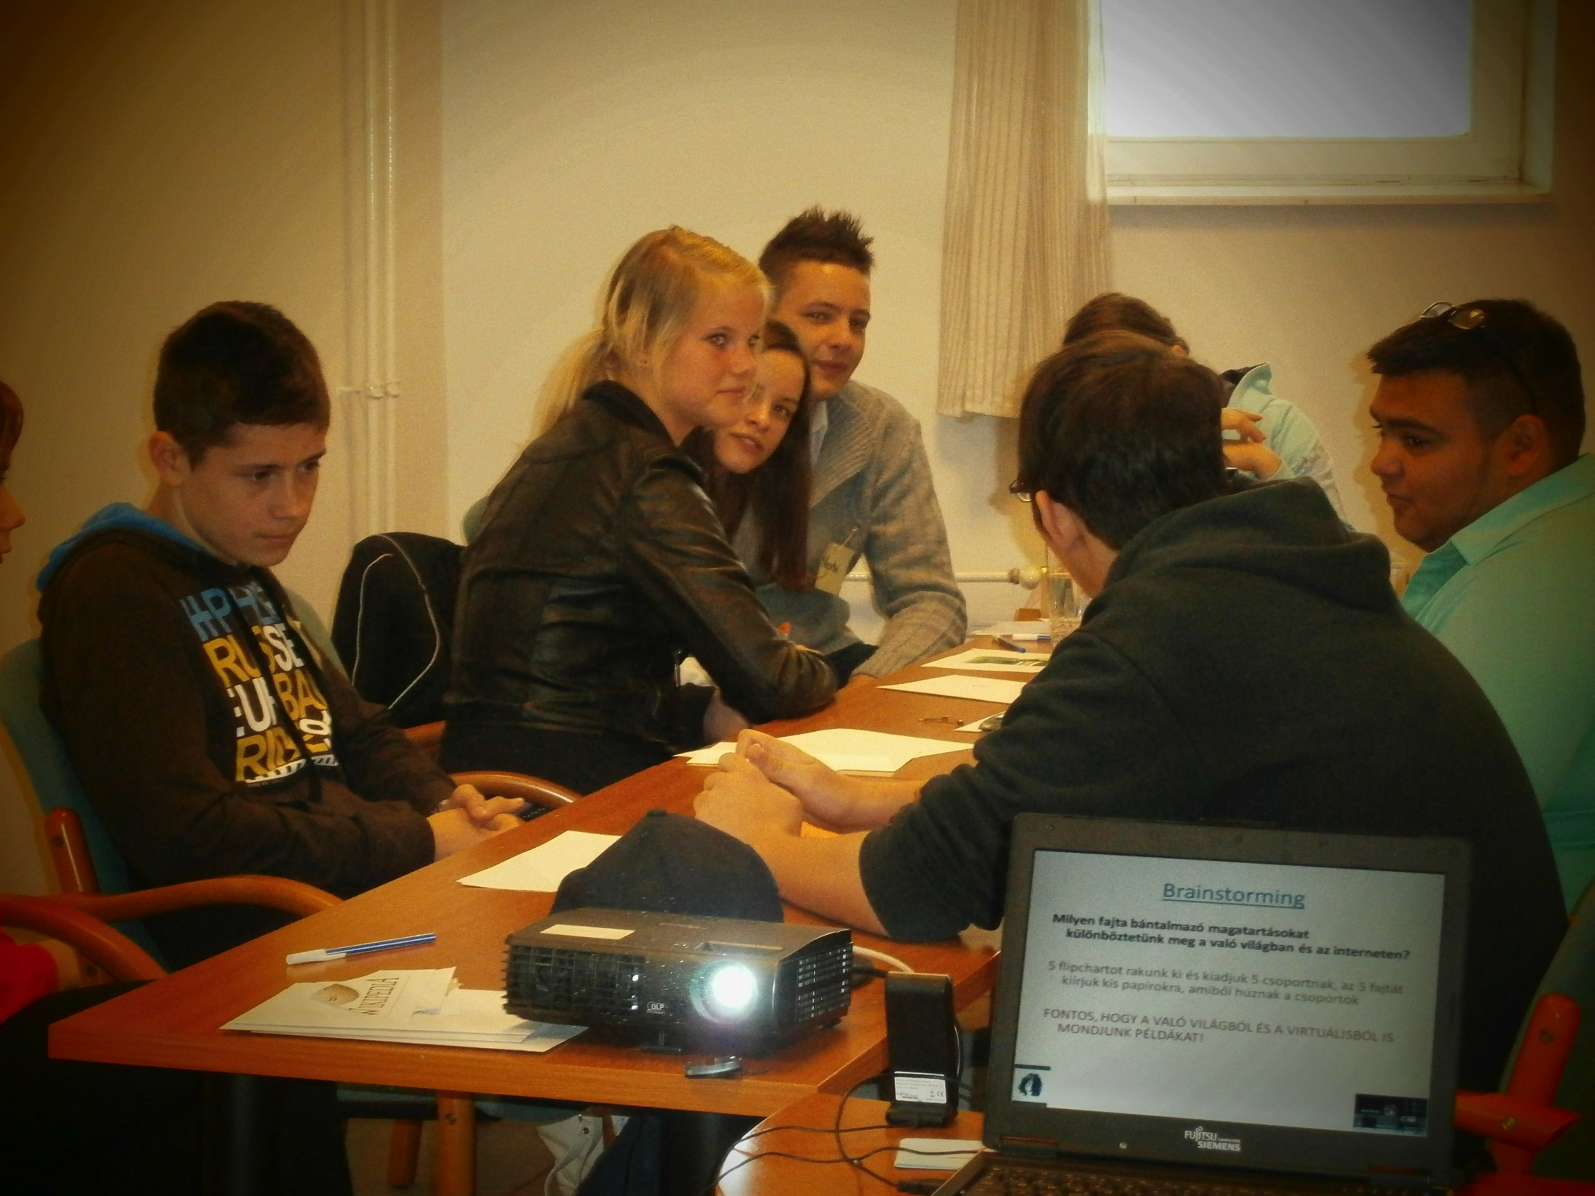
Product #3: Peer mentor program (TABBY Friends)
1x8 hours training for 14-15 y.o. students
interactive games
using the TABBY videos
30 peer mentors trained (2011-2013)
moduls
sensitization
how to early detect and manage bullying and cyberbullying situations
how to help students in need
how to motivate peers to stand up for each other
how to deal with targets, offenders and bystanders
risky situations
when it is necessary (a must) to tell an adult

Slide 9
Survey results – the TABBY “specialities”
Most of the answerers (59%) reported having been suffered some kind of cyberbullying at least 2 times in the last 4 months. School bullying has been suffered significantly less likely
Offending was more likely admitted than being bullied (cyberbullying)
Risk factors
 | cybervictim | severe cyberbully | mild cyberbully
female |  | -
online popularity |  | +
time spent online | + | + | +
academic achievement | -
school victim | + | + | +
school bully | + | + | +

Slide 10
Testing the efficiency of the program – Tabby profiles
Most pupils were classified into the middle risk group in both data collections
Positive result: high risk groups reduced, and low risk groups enlarged
Higher rate of development in the experimental group. But control group showed development as well
risk

Slide 11
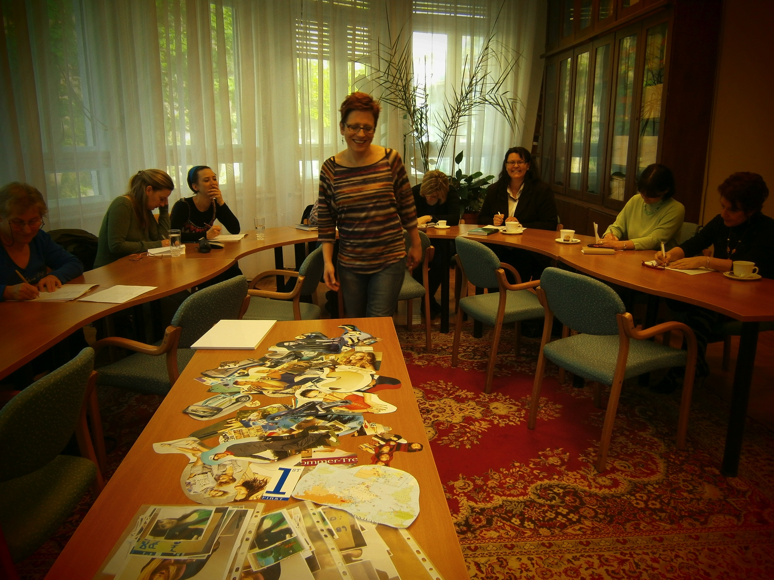
Reasons why TABBY is innovative
Program complexity – teachers, parents, students + data collection
User-friendly tools were developed
Blueprint program: its products available for free, and can be utilized in different countries
The program justified that active participation of teachers is necessary to lower the risk of notifying, managing and preventing online bullying incidents
Joint (anti-bullying) activities of school staff and students enhance develops mutual trust ⇒ friendlier and safer school environment
Tabby toolkit raises awareness itself, and teaching to early detect and manage online risks

Slide 12
Reasons why TABBY is needed to continue in Hungary
this was the first anti-bullying program in Central- and Eastern European countries
in Hungary, it remains the one and ONLY anti-bullying program to this day
tools are available to continue
What is missing:
experts (trainers, psychologists) to consult schools
TABBY friends are leaving their schools (aging)
TABBY teachers need update and continuous consultation
more schools should be involved in the program

Slide 13
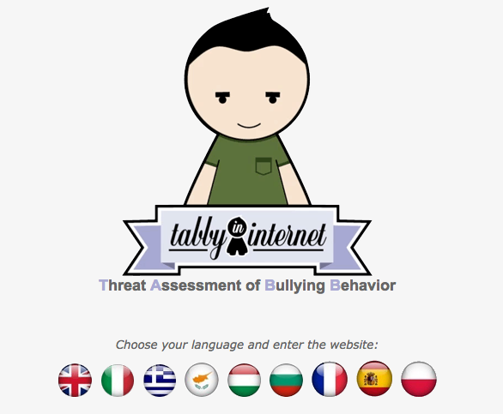
THANK YOU | Q&A
contact: | website
partikat@gmail.com | tabby.eu

