Slide 1
Campaign: “Veilig zakelijk internetten” To make entrepreneurs aware of cybercrime
Ellen Jacobs, projectmanager MKB-Nederland
Luxembourg, December 17, 2015

Slide 2
The Project
The challenge
Entrepreneurs are hardly aware of the impact of cybercrime on their business while:
€ 7,5 billion euros business damage per year
The Netherlands target country for cybercrime
Our approach
5 roadshows in cooperation with the regional networks for
safely entrepreneuring → awareness
The offer of 300 ‘live’ hacks → a call to action!

Slide 3
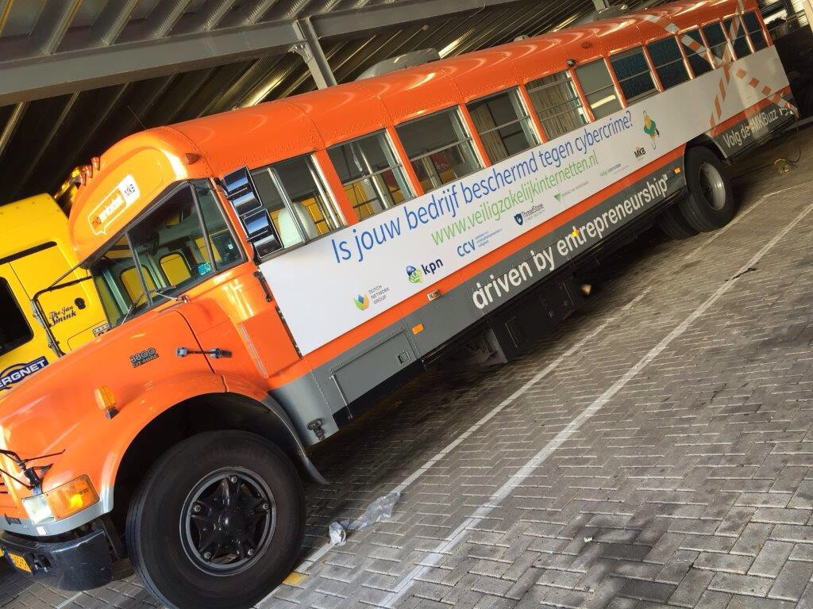
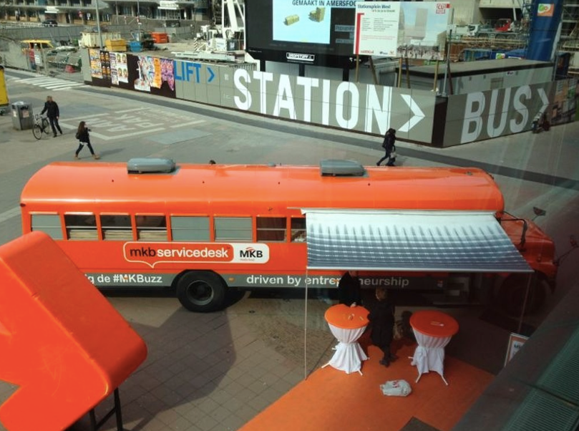
Roadshows
MKBuzz with IT and insurance advisor Information program/seminar + information market in cooperation with the local entrepreneurs associations and local authority | Promotion team Media attention Digital magazine with interviews with experts and local authorities
MKBuzz

Slide 4
Digital magazine

Slide 5
Free ethical hack for entrepreneurs

Slide 6
Hack results
226
Of 300
 | Top-5 business impact
1. | Easy access to relevant data
2. | Routers/firewalls easy to manipulate
3. | Webshops and websites badly programmed or maintained.
4. | Overdue maintenance
5. | Servers and websites already been hacked
Entrepreneurs that applied
\
‘Hacks’
535
Amount of scanned hosts
76,82%
INSUFFICIENT
23,18%
SUFFICIENT
Hacks versus scores
Feed back appointments
91
Of 226
No response to invitation
21
Of 226
No-show at appointment


Feed back conversations
114
Of 226
1-2
3-4
5-6
7-8
9-10

Slide 7
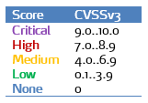

Slide 8
Conclusions
SME’s are positive about the campaign and especially about
the free hack;
Awareness still lacks, based on the no show at the feedback appointment (almost 50%);
Main cause for cybercrime vulnerability: overdue maintenance;
The most critical vulnerabilities are caused by people (lack of
attention;
IT suppliers (networkhosts, webdevelopers) are inspired to
develop new services/ propositions, in the spirit of this campaign.

Slide 9
Top 5 causes
Impact potential hacks is recognised insufficiently
SME’s just start acting after they have been attacked by cybercrime;
Digital safety demands attention, attention, training, procedures
and technical investments → average SME lacks 4 of 6;
Lack of attention and overdue maintenance most occuring vulnerability;
‘Gap’ between the offer of suppliers and the expectations of SME’s.
IT-suppliers experience an offer in this area as a shortcoming of
their own services.

Slide 10
Evaluation
58% states more awareness regarding cybercrime
45% took measurements after the intake for the hack
1 on 5 SME’s took improvements regarding WIFI and personnel IT protocol
25% did this after the hack
83% of the hacked SME’s puts cybercrime permanently on the agenda
77% does not consider cybercrime insurance
Before the hack 72% of the SME’s did not put their IT network on regular check. After the hack 84% considers a regular check

Slide 11
Finally
We did not sell all 300 hacks;
SME’s gave unsufficient priority to the feed back of ‘their hack’;
75% of the SME’s that has been hacked is unsufficiently protected against cybercrime;
The hacker business is quite inventive → every day brings new
tricks to enter IT-enviroments.
So..
our mission to make SME’s aware of
cybercrime is not accomplished…yet..

