Slide 1
Cyberbullying at schools
Education Development Association “Landmarks”
Luxemburg, 17-18 december 2015.

Slide 2
Cyberbullying at schools
Main issue – why cyberbullying?
Cyberbullying is considered a crime, under the Polish and European law.
It is also a devastating psychological phenomenon to young people.
Taking legal measures does not undo the psychological consequences of cyberbullying, both those of the victim and the perpetrator.
Thats why the main issue is to identify the problem, prevent its occurrence and supress it at an early stage, before any psychological damage is done.

Slide 3
Cyberbullying at schools
How to respond to the problem?
3 keywords „to understand, to see and to react”
3 groups of stakeholders teenagers, parents and teachers
3 kinds of activities meetings, social media and publication

Slide 4
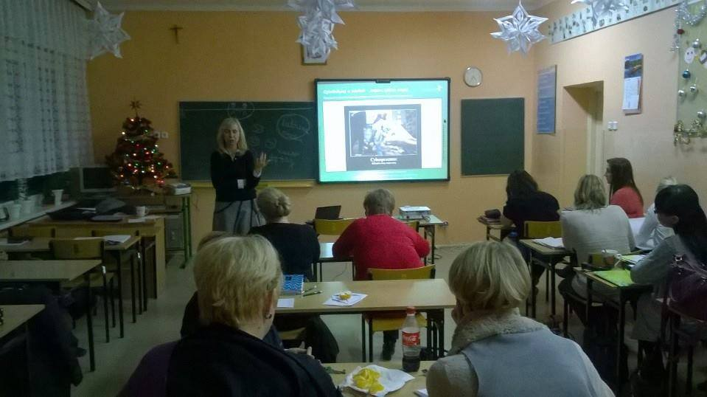
Cyberbullying at schools
Main activities - meetings
trainings for teachers, school counsellors and principals
workshops for secondary school students
educational meetings for parents
Untill now we have visited a total of 85 facilities where we had 85 training sessions for over 1,800 teachers, 40 sessions of workshops for over 900 students and 15 educational meetings for parents.

Slide 5
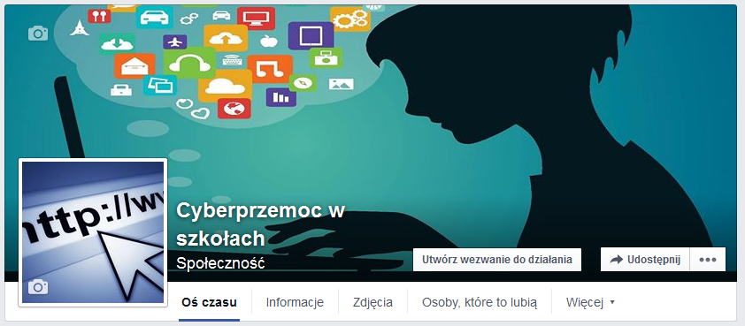
Cyberbullying at schools
Main activities – social media
We launched and we manage a Facebook Page (https://www.facebook.com/cyberprzemocwszkolach) - the page has over 450 followers. We want this page to be primarily educational, therefore we publish external multimedia materials as well as our own resources and infographics on cyberbullying. We plan to reach 700 followers by the end of 2015.

Slide 6
Cyberbullying at schools
Main activities – publication
We prepare a brochure with content corresponding to the training sessions for teachers.
The brochure was printed in 1400 copies and sent free of charge to participating schools and to teachers who applied for one on Facebook.
The publication is also available as a .pdf file on our website.

Slide 7
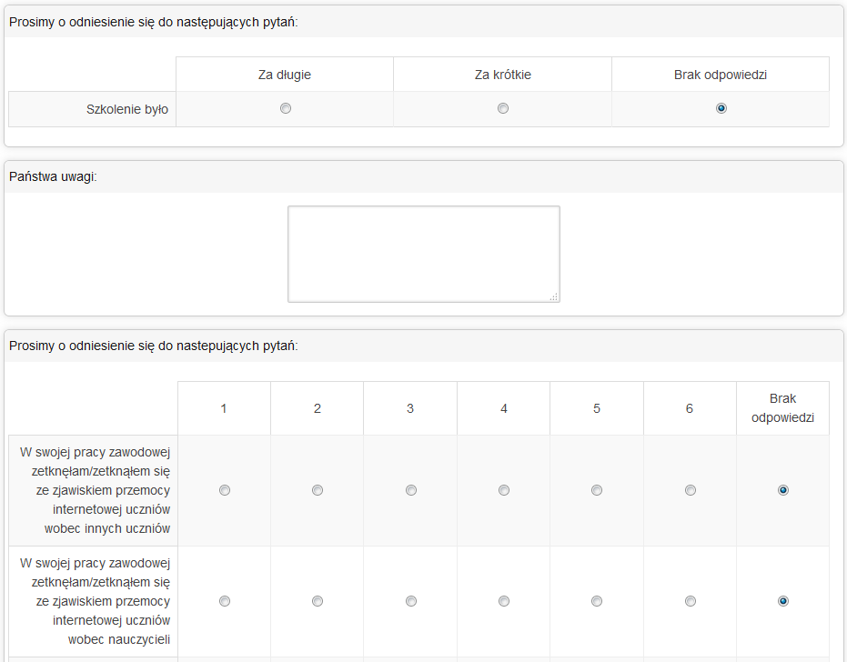
Cyberbullying at schools
Has there been an outcome or impact evaluation?
Done by an external consulting firm.
19 research questions, e.g.:
did the training contribute to the professional development of its participants?
does the participant know how to respond to cyberbullying and will she/he be able to react if needed?
Based on surveys and phone interviews with stakeholders.
The methodology of the evaluation relied on a 6-point Likert-type scale.
The average value of satisfaction to consider the project’s results achieved is “4”.
The score for particular areas ranged between „4.85” and „5.44”.

Slide 8
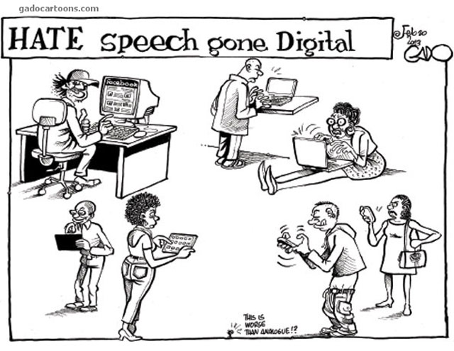
Cyberbullying at schools
Why is it important to the other EU countries?
The Internet has no boundaries, just like social media and the problem of cyberbullying or hate speech. These communication tools are virtually the same in all Member States, as well as mental state of 13, 14 or 15-year-olds.
The xenophobic dimension of cyberbullying is very important aspect in the pan-European context.
Condoning cyberbullying of teenagers means we have to accept that in 10 year it will result in escalation of hatred against immigrants, people of different ethnic origin, religion, or sexual preferences.

Slide 9
Cyberbullying at schools
If you want to know more…
… please see our webpage (www.drogowskazy.com.pl) or write us (biuro@drogowskazy.com.pl).
We are thinking about preparing an application to Erasmus +, Key Action 2 — Cooperation for innovation and the exchange of good practices. The subject of the project will be, as you may see, preventing of cyberbullying. That is why we are looking for partners in other EU countries interested in this phenomenon.
Thank you for your attention

