Slide 1
Swedish National Fraud Centre
Presentation for the projekt ”Don’t try to fool me!”
European Crime Prevention Award 2016-12-14
Anna-Lena Tapper/ Police Inspector
Notes:
Hello ladies and gentlemen and members of the jury of Crime Prevention Award…. Here comes the short presentation of the Swedish prevention projekt for elderly ”dont try to fool me!.
.

Slide 2
Cases of fraud
15000 frauds per months reported
120 directed against elderly persons, less than one percent
Increasing
Goal to prevent and reverse the trend
Notes:
- Increasing - We want to prioritize to try as good as we could to stop organized crime where perpetraters target more frigale persons.
During the first 6 mounth of 2015 reportet crime against elderly increased 40 procent compered with the same 2014. We wanted to reverse the trend.

Slide 3
Crime prevention – How?
External parties. PRO, SPF, BOJ
The ”Case method” teaching approach
Get all the facts
Educate - knowlege and tools
Worked togheter, tryouts
Together we launched to as many we could
Notes:
-We could not do it by ourself , we needed help from already existing groups in sociaty. Therefore we invitet the two largest organisations for retired persons and the national association for supporting crime victims NOT really intressted in another broschyre….. So…
-Case method- the same police use at the police acadamy and other courses. You are given the the surcumstanses film and should figure out the answers and possible solutions.
-We did not have all the facts- decided to go deep in an scientific way. We read and catogorysize 3500 police reports with Crime against elderly.
From that we learned how the crime happens and how perpetrators targets and acts in diffrent invironments and situtaions.
-Worked togheter, pilots feedback for example subtitels, use of word but most importent from all the pilots. We must put in the COFEE BREAK.
We launced to everyone we could thing of. Churches, municipalities, lokalpolis, social services, etc

Slide 4
Frauds against elderly
Don not try to fool me!
An education about how elderly persons can protect themselves against fraudsters
Notes:
With the interaction partners we launced to got the education package and within their communities They should find intrested instructors to spread the education pakage. We would delivered all knowage that they needed with the sientific report. The only thing they had to have on forehand was experience to talk infront of a group and to hande a powerpoint. Each instructor had smal groups of about 10-20 elderly. X 3

Slide 5
Key messages
Increase knowledge of fraud
Common frauds x 3
Reflection
Exercises
If victim of fraud
Notes:
-What is a fraud – Deception, gain for perpetratior och loss for victim- intent
-Impact of Age = The average age for what kind of crime, Why elderly? They are socialy helpful and have time, they are active during the day, they are easy targets because of parhaps poorer fysiks
Elderly seldom report fraud. 70% of Reported frauds are completed frauds. Wich makes the conclusion that dark numbers are big.
-Most common modus operande X3
-Reflektion. Se a start of a film with fraudmodus and then stop the movie and discuss what could happen. Example Would you let this man in.
- Excersises on what to do? Diskussions on diffrent ways.
- If you becoma a victim, - what you do who you contact and later what the police do and if it goes to trail what happens.

Slide 6
Do not try to fool me! Education serie of three
Scientific report and broschyr
Meeting instructions and instruction movie
Three movies with diffrent themes
Be on your guard
Your home is your castle
Call the bluff
Broschyres for every theme
Notes:
Package 1Be on your guard – prevention for fraud in public invironment 2. – prevention for fraud in your home 3. –prevention when someone to make you tell bank / kreditcards details, sell you things or service ( roof / snow )
Themes

Slide 7
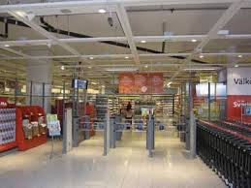
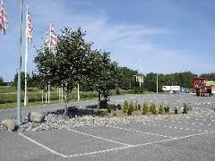
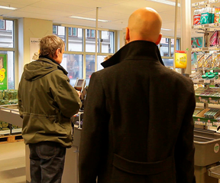
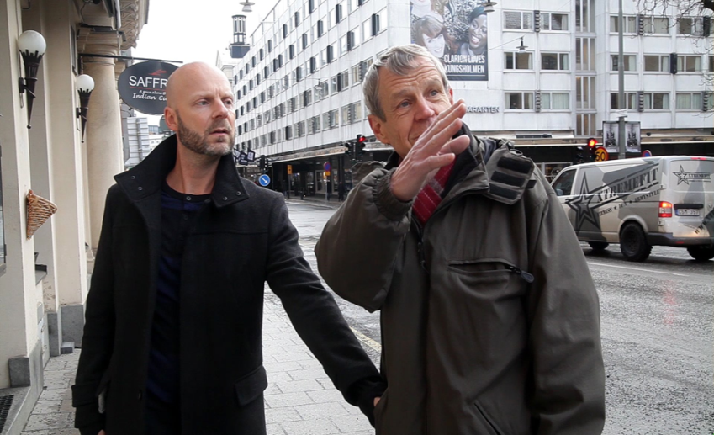
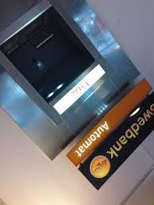
Notes:
From first theme Be on your guard. – Advise to prevent theft and fraud that happens in public invirement.
Tha absolut most common modus to get your credit card and kod is to stand behind the elderly person look in the supermarket / ATM and then diverstion. Ex maps, changing money, etc. SEE the situation not the person.
SEE the

Slide 8
Reflection and excersise….
Be on your guard
Notes:
Film and then Excersise

Slide 9
Questions

Slide 10
Contact information
Head National Fraud Centre
Mr. Mattias Falkbåge +46734-25 60 66 mattias.falkbage@polisen.se
“AntiFraud warrior and the protector of elderly”
Ms. Anna-Lena Tapper +46709-62 19 45
anna-lena.tapper@polisen.se

Slide 11
Thank you

